Slide 1
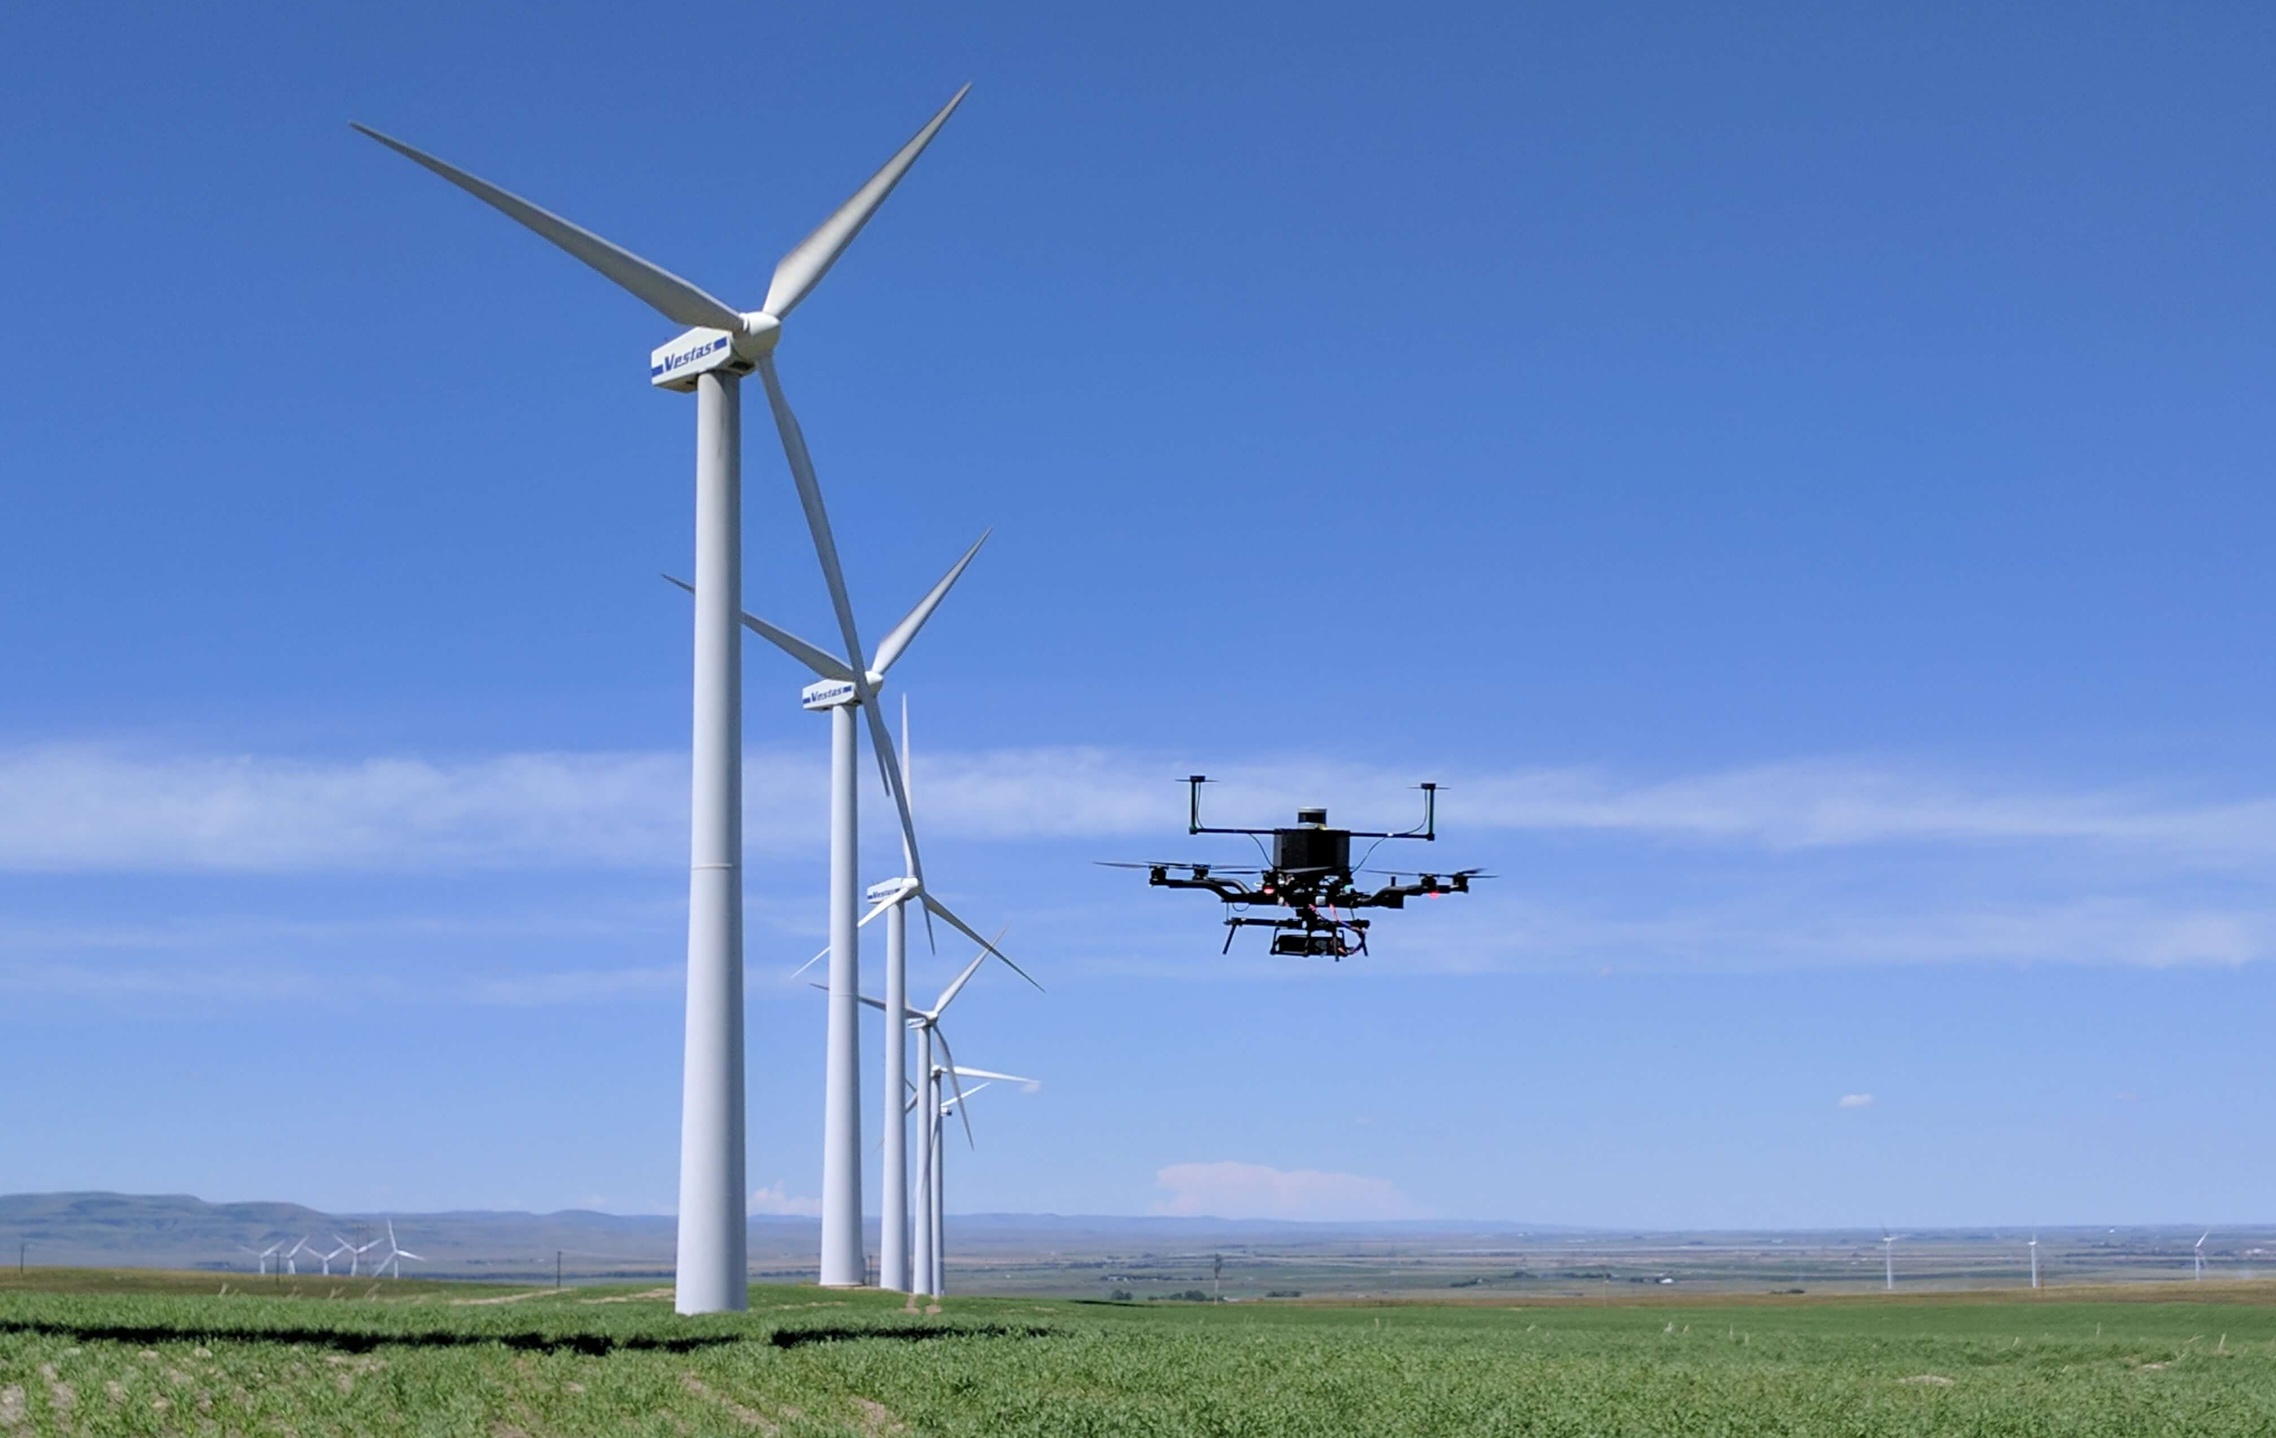
x.x.x Case Study – xxxxxx
Location:
Date:
Company:
Campinas, SP
Brazil
October,
2020
Company Logo
SAMPLE PICTURE
Value added (ranked)
Time saving
Cost saving
Quality increase
Safety increase
Please Rank the value added
Operational Characteristics:
Drone: Multirotor (Speedbird DLV-1)
Autonomy Level: 2 - Partial
Payload: sensor, cargo (xxkg)
Operation Mode: VLOS/BVLOS
Operating Environment: Urban/Rural
Total distance/area covered: 5km
Total flight time: 12min
Total number of flights: 5
Airspace: uncontrolled/controlled
Further operation-relevant details: Computer vision, GPS-denied environment
Problem Description
What is the current status/problem?
…
Dirty/dull/dangerous
Areas/Objects hard to access
Solution Description
How was the problem solved?
…
Output data: e.g. thermal image, point cloud, etc.
Software used
Time/costs saved
Safety/quality increased
Further Observations/Findings
Additional value added, etc.
…
Humanitarian aid
Better project management
Regulatory circumstances:
Type of authorization:
Standard/Basic (e.g., open category, Part107)
Special authorization (e.g., specific, waiver)
Certified (e.g., Part135, LUC, etc.)
Use of UTM Service provider (Yes/No)?
SORA or equivalent applied (Yes/No)
If yes, what were the top risks to mitigate
E.g. over-people operation
If required, just click the box and type an „x“

